Slide 1
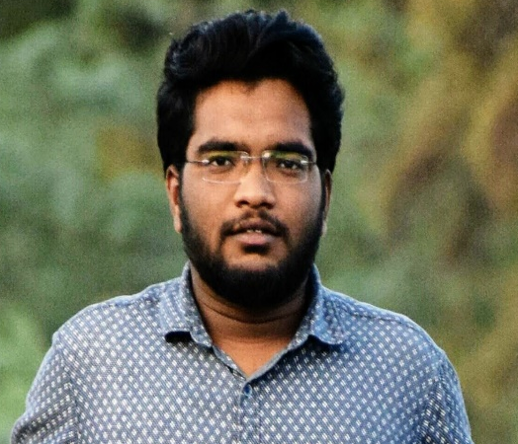



Sreekanth Gandodi
Education and certificates
Bachelor of Technology
Computer Science & Engineering
Analyst/Software Engineer
Email ID:
Sreekanth.gandodi@capgemini.com
Skills
Core Python
Oracle SQL
RDBMS
PL/SQL
PostgreSQL
SQL Server
Strengths
I can implement my Theoretical, Logical, Technical skills in the practical real life environment with committed & dedicated people, which will help me to explore myself fully and realize my potential.
Willing to work as a key player in challenging & creative environment. Also to secure a responsible career opportunity to fully utilize my training and skills, while making a significant contribution to the success of the company.
Ready to learn new technologies and implement them to further improve my knowledge.
Eager to work in a team of dedicated people and serve a key role in the enhancement and development of the project.
Has working knowledge on Oracle SQL, PLSQL core Python, and MONGODB.
Achivement
Examination and Evaluation System
Completed case study of Examination and Evaluation System done during the Training period.
In this case study I am using oracle SQL for creating the database and PLSQL for write some Procedures ,functions and triggers.
Database
Oracle SQL database
No SQL database – MongoDB
Postgres
Additional Details
Quick Learner Time management Leadership
Disciplined and Responsible
Project: worked in TEM project with Signant health client as a database Developer. worked using Postgres.
-worked on Abbott project as a Application support analyst.
-Currently working in Ryder project as a Application Delivery & Support Analyst
Areas of Interest and Hobbies
Travelling
Cooking
Check my work on Github

